Slide 1
词向量的情感方向研究
郁可人

Slide 2
Content
Extension of word embeddings
Relationship between representation learning and Algebraic method
Strange geometry of word embeddings
Sentiment word embeddings (my work)

Slide 3
Extension of word embeddings
Decision tree
Interpretable
Difficult to find the relationship between variables
Word embeddings are distributed representation
Non-distributional word vector (Faruqui, 2015)
Dimension reduction
PCA(linear) v.s. t-SNE(non-linear)
complete name of PCA is Principal Component Analysis
t-SNE tending to retain the local features in data
Feature selection
Priori knowledge of word vectors
Sparse representation: L0-norm->L1-norm
Low rank representation: rank->nuclear norm
Compressed sensing(西瓜书P.257)

Slide 4
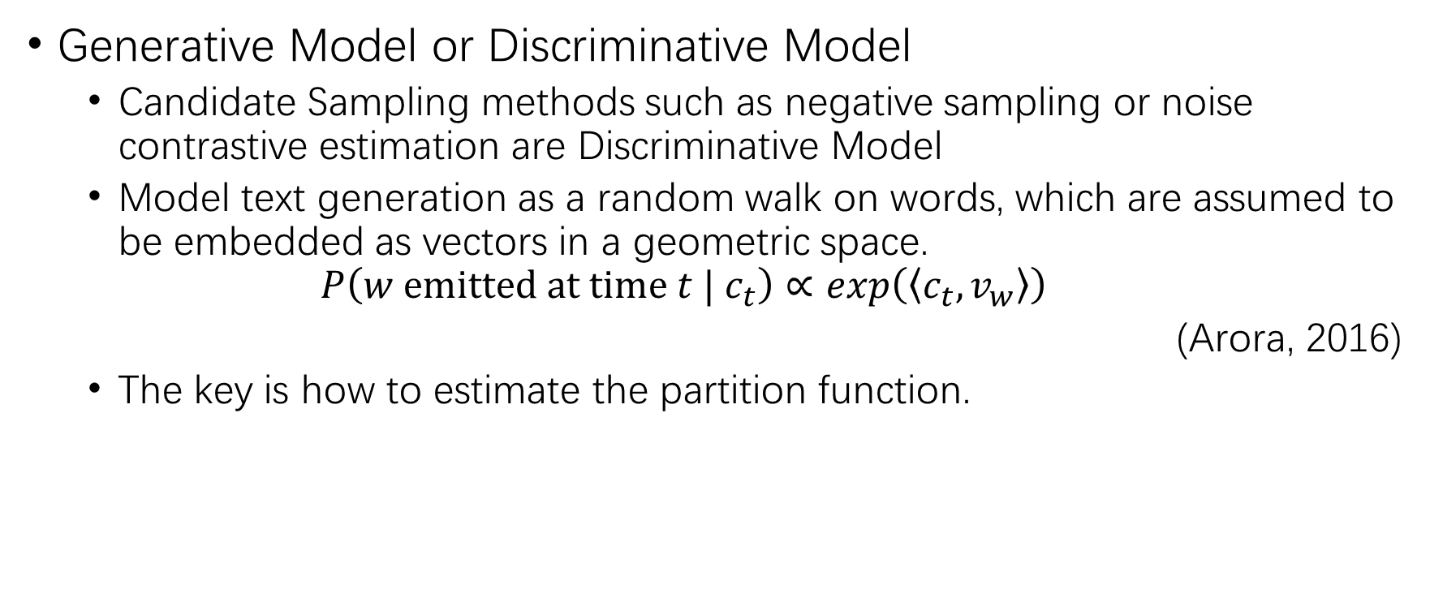
Extension of word embeddings
Generative Model or Discriminative Model
Candidate Sampling methods such as negative sampling or noise contrastive estimation are Discriminative Model
Model text generation as a random walk on words, which are assumed to be embedded as vectors in a geometric space.
$$P\left(w emitted at time t | c_{t}\right)∝exp\left(\left\langle c_{t}, v_{w}\right\rangle \right)$$
(Arora, 2016)
The key is how to estimate the partition function.

Slide 5

Relationship between representation learning and Algebraic method
Linear model (Algebraic method)
$$y=w^{T}x+b$$
Generalized Linear model
$$y=g^{−1}\left(w^{T}x+b \right)$$

Slide 6
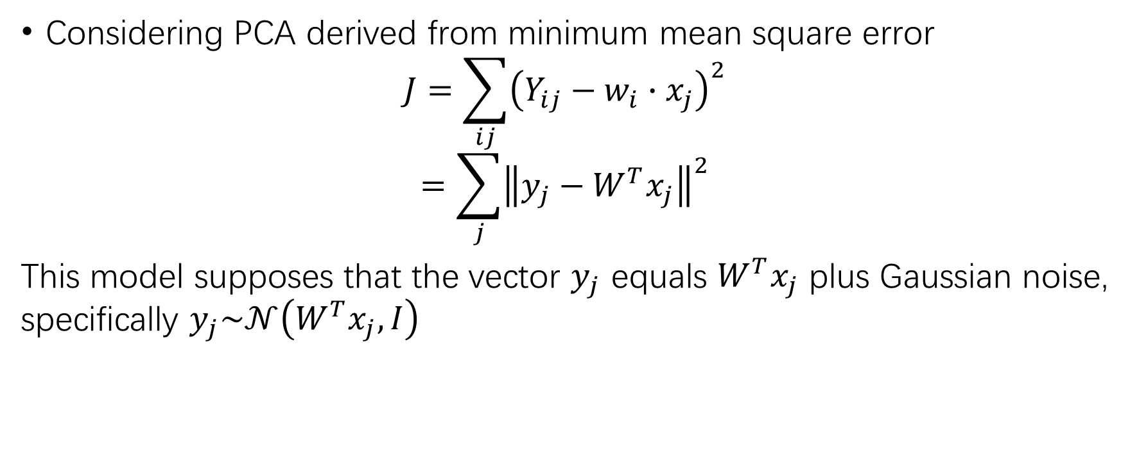
Relationship between representation learning and Algebraic method
Considering PCA derived from minimum mean square error
$$J=\sum_{ij}{{\left(Y_{ij}−w_{i}∙x_{j}\right)}^{2}}$$
$$=\sum_{j}{{\left\|y_{j}−W^{T}x_{j}\right\|}^{2}}$$
This model supposes that the vector $y_{j}$ equals $W^{T}x_{j}$ plus Gaussian noise, specifically $y_{j}\sim 𝒩\left(W^{T}x_{j}, I\right)$

Slide 7

Relationship between representation learning and Algebraic method
Exponential family PCA is an extension of PCA
$$P\left(x|θ\right)=P_{o}\left(x\right)exp\left(xθ−G\left(θ\right)\right)$$
$$\log{P\left(x|θ\right)}=\log{P_{o}\left(x\right)}+xθ−G\left(θ\right)$$

Slide 8
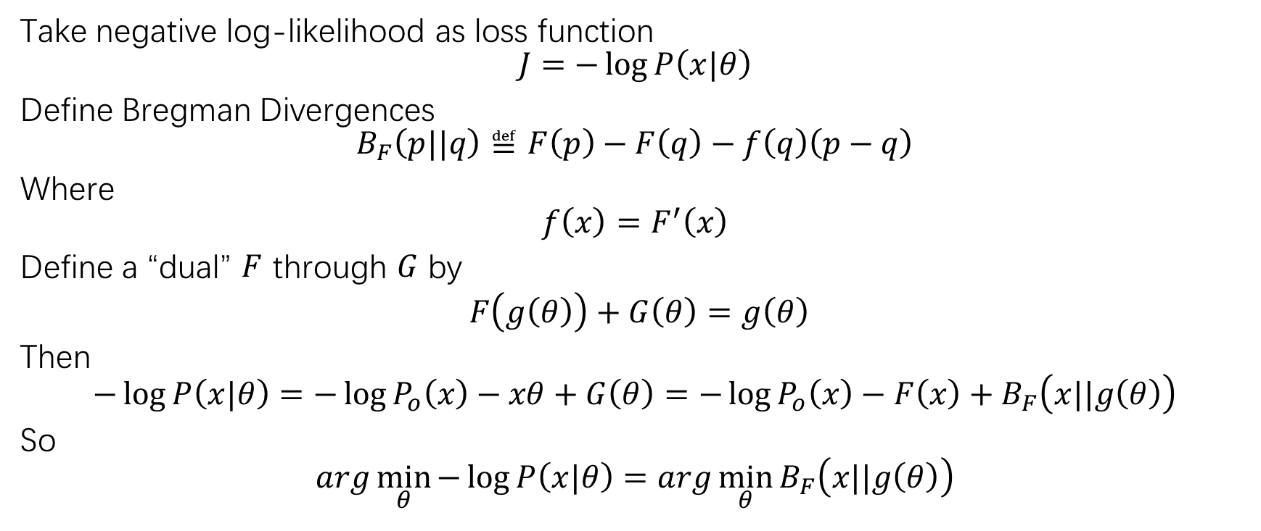
Relationship between representation learning and Algebraic method
Take negative log-likelihood as loss function
$$J=−\log{P\left(x|θ\right)}$$
Define Bregman Divergences
$$B_{F}\left(p||q\right)≝F\left(p\right)−F\left(q\right)−f\left(q\right)\left(p−q\right)$$
Where
$$f\left(x\right)=F^{′}\left(x\right)$$
Define a “dual” $F$ through $G$ by
$F\left(g\left(θ\right)\right)+G\left(θ\right)=g\left(θ\right)$
Then
$$−\log{P\left(x|θ\right)}=−\log{P_{o}\left(x\right)}−xθ+G\left(θ\right)=−\log{P_{o}\left(x\right)}−F\left(x\right)+B_{F}\left(x||g\left(θ\right)\right)$$
So
$$arg\min_{θ}{−\log{P\left(x|θ\right)}}=arg\min_{θ}{B_{F}\left(x||g\left(θ\right)\right)}$$
还有人基于Bregman散度去统一正反KL散度的认知。推导KL散度就是香农熵的Bregman散度。Bregman散度本身是基于一阶泰勒展开的一种偏离度的度量

Slide 9
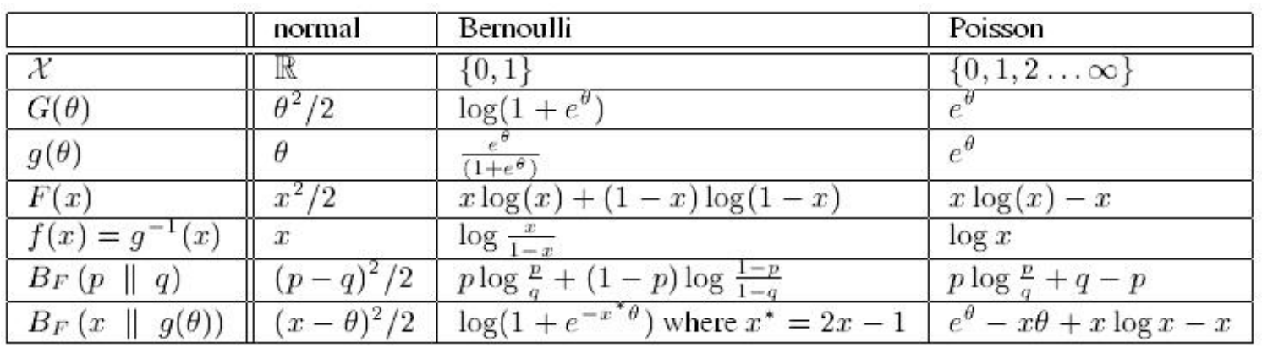
Relationship between representation learning and Algebraic method

Slide 10
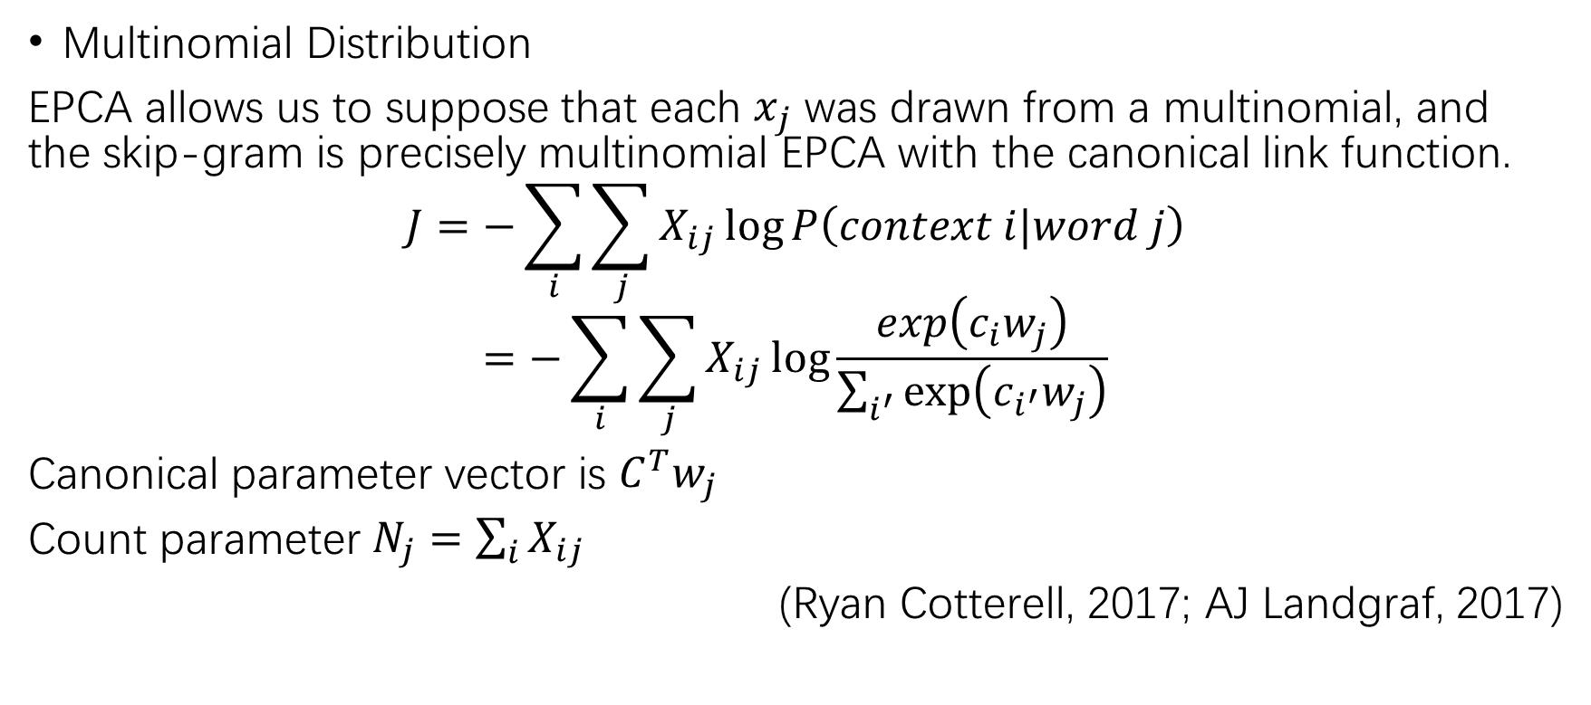
Relationship between representation learning and Algebraic method
Multinomial Distribution
EPCA allows us to suppose that each $x_{j}$ was drawn from a multinomial, and the skip-gram is precisely multinomial EPCA with the canonical link function.
$$J=−\sum_{i}{\sum_{j}{X_{ij}\log{P\left(context i|word j\right)}}}$$
$$=−\sum_{i}{\sum_{j}{X_{ij}\log{\frac{exp\left(c_{i}w_{j}\right)}{\sum_{i^{′}}{exp⁡\left(c_{i^{′}}w_{j}\right)}}}}}$$
Canonical parameter vector is $C^{T}w_{j}$
Count parameter $N_{j}=\sum_{i}{X_{ij}}$
(Ryan Cotterell, 2017; AJ Landgraf, 2017)

Slide 11
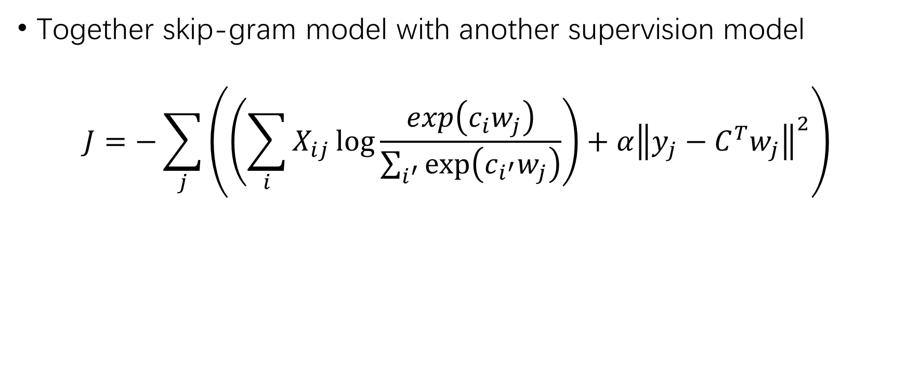
Relationship between representation learning and Algebraic method
Together skip-gram model with another supervision model
$$J=−\sum_{j}{\left(\left(\sum_{i}{X_{ij}\log{\frac{exp\left(c_{i}w_{j}\right)}{\sum_{i^{′}}{exp⁡\left(c_{i^{′}}w_{j}\right)}}}}\right)+α{\left\|y_{j}−C^{T}w_{j}\right\|}^{2}\right)}$$

Slide 12
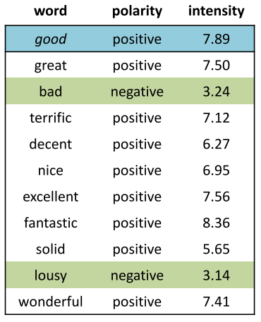
Strange geometry of word embeddings
Normalization
Two task of word embeddings
Word similarity
(Liang-Chih Yu, 2018)

Slide 13
Strange geometry of word embeddings
Normalization
High frequency words’ vectors in Glove have a larger model length.
High frequency words’ vectors in Skip-gram/PMI have a smaller model length.
Difference of model length is usually erased by normalization.

Slide 14
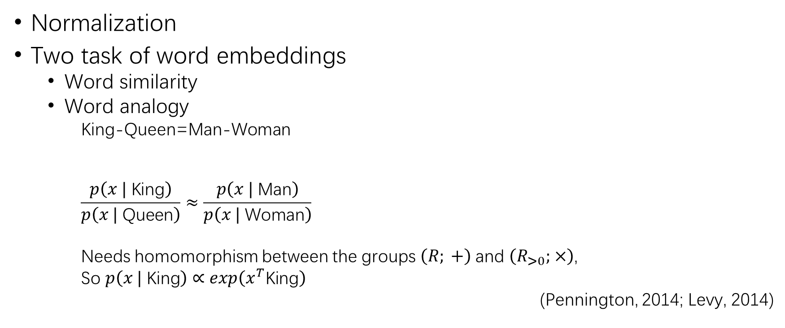
Strange geometry of word embeddings
Normalization
Two task of word embeddings
Word similarity
Word analogy
King-Queen=Man-Woman
$$\frac{p\left(x | \text{King}\right)}{p\left(x | \text{Queen}\right)}≈\frac{p\left(x | \text{Man}\right)}{p\left(x | \text{Woman}\right)}$$
Needs homomorphism between the groups $\left(R; +\right)$and $\left(R_{>0}; ×\right)$,
So $p\left(x | \text{King}\right)∝exp\left(x^{T}\text{King}\right)$
(Pennington, 2014; Levy, 2014)
King
Man
Woman
Queen

Slide 15
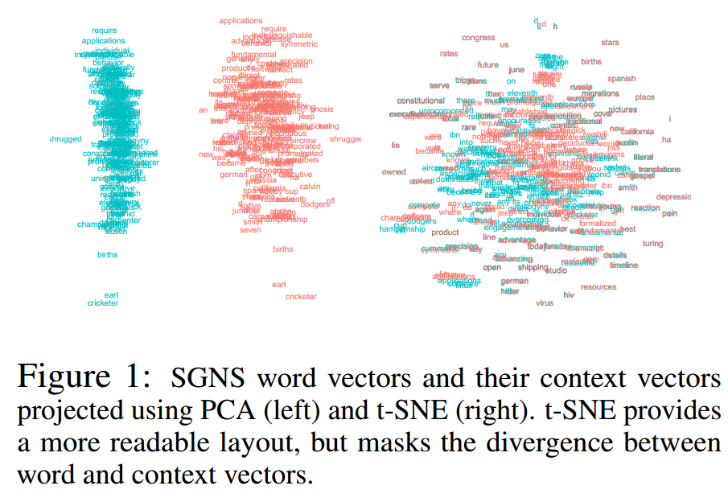
Strange geometry of word embeddings
The “isotropic” is often be used as a prior knowledge, but is not always ture.
(Mimno, 2017)

Slide 16
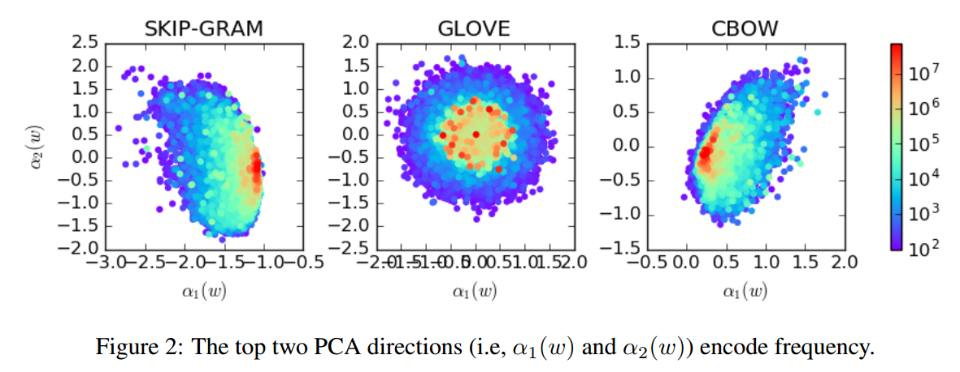
Strange geometry of word embeddings
(Jiaqi Mu, 2018)

Slide 17
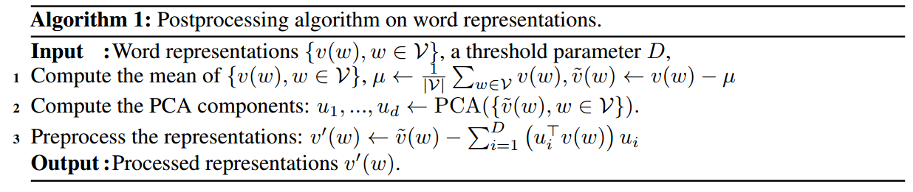
Strange geometry of word embeddings
To gather more “isotropic” word embeddings
Consider that the top PC direction is caused by dataset bias.
(Jiaqi Mu, 2018)

Slide 18
Strange geometry of word embeddings
Look back to the 2-dim vector space
King
Man
Woman
Queen

Slide 19
Strange geometry of word embeddings
Look back to the 2-dim vector space
King
Man
Vertical to Gender direction
Woman
Queen
Gender direction

Slide 20
Strange geometry of word embeddings
Look back to the 2-dim vector space
King and Queen should have oppotise vectors on gender direction, and similar vectors on direction vertical to gender direction.
King
Man
Vertical to Gender direction
Woman
Queen
Gender direction

Slide 21
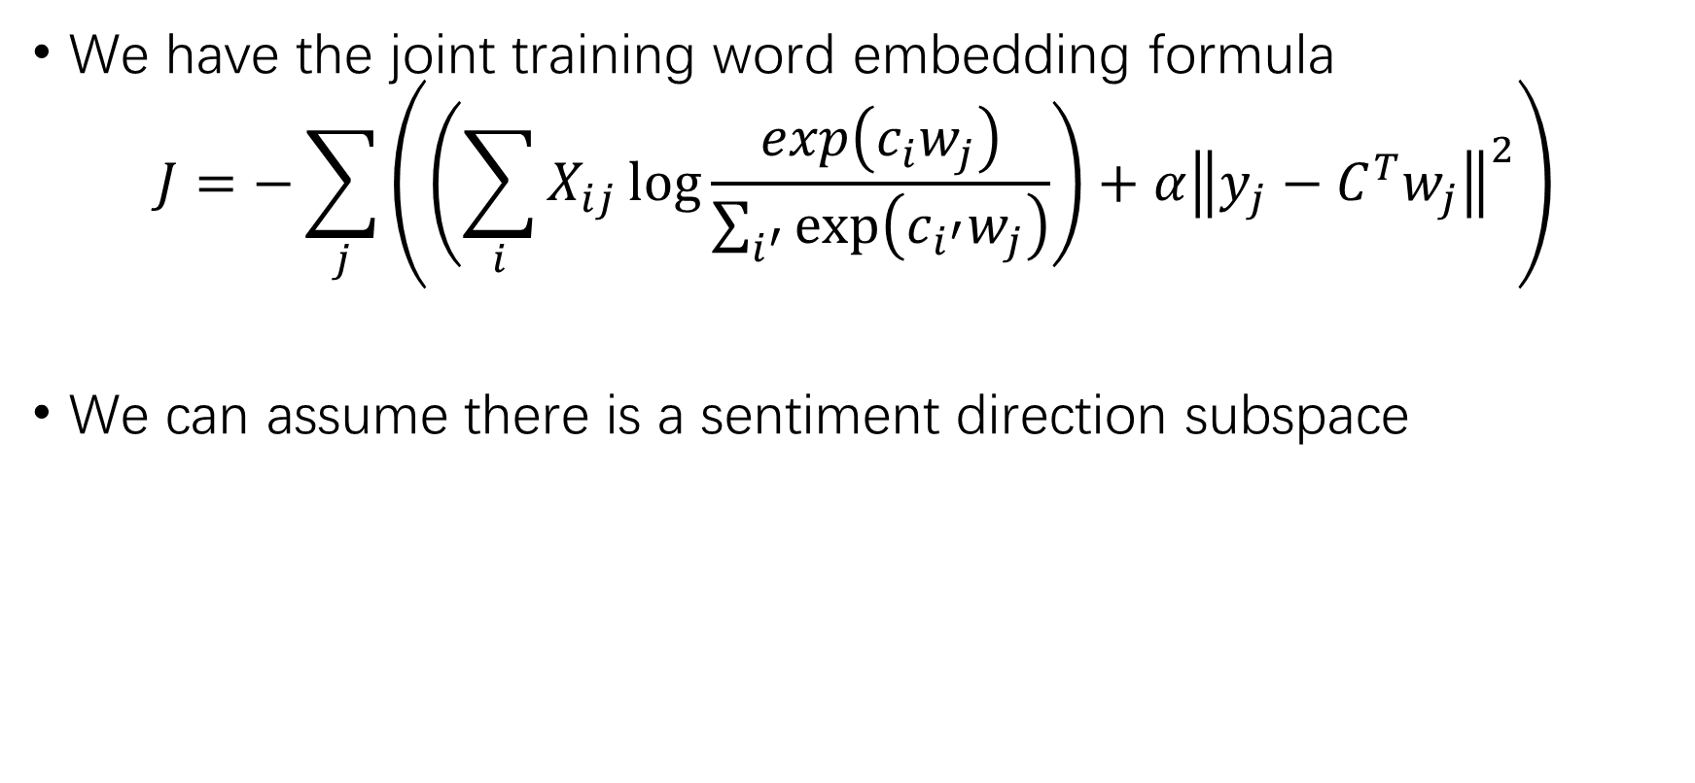
Sentiment word embeddings (my work)
We have the joint training word embedding formula
$$J=−\sum_{j}{\left(\left(\sum_{i}{X_{ij}\log{\frac{exp\left(c_{i}w_{j}\right)}{\sum_{i^{′}}{exp⁡\left(c_{i^{′}}w_{j}\right)}}}}\right)+α{\left\|y_{j}−C^{T}w_{j}\right\|}^{2}\right)}$$
We can assume there is a sentiment direction subspace

Slide 22
Sentiment word embeddings (my work)
‘Bad’ have high rank in nearest neighbor
words of ‘good’.
Positive words is more than negative words
in nearest neighbor words of ‘good’.
Inference:
Word embeddings catch sentiment information
to some extend, but not obviously.
(Liang-Chih Yu, 2018)

Slide 23
Sentiment word embeddings (my work)
I picked 16 pair words
with antisense
but close to each other
in vector distance.
Using the seed words
to find the main components.
good bad 0.7190051208276235 happy sad 0.5354614339594703 best worst 0.5835110762141579 great terrible 0.5425338324859197 better worse 0.6248995223961045 amazing awful 0.5293680460915142 cute annoying 0.5144807557825171 awesome weird 0.5646271009195323 excited disappointed 0.5144381803099171 glad disappointed 0.5871208227419177 yay ugh 0.5541232741199669 funny boring 0.5214890457196143 strong weak 0.6157288994523519 interesting weird 0.5364337341550329 thankful sorry 0.5547394269192794 greatest worst 0.5264488290421043

Slide 24
Sentiment word embeddings (my work)
Word embeddings
fastText-crawl-300d-2M (Piotr Bojanowski, 2017)
SSWE_h(50) (Duyu Tang, 2014)
Random_picked
Method
Compute the means of each pair of vectors respectively.
Centralize vectors to corresponding pair centers.
Do PCA to centralized vectors, set the top principle component direction as sentiment direction.

Slide 25
Sentiment word embeddings (my work)
Sentiment-PCA | fastText-crawl-300d-2M | SSWE_h(50) | Random_picked
1 | 0.28633193 | 0.63171184 | 0.19406726
2 | 0.11676843 | 0.11711445 | 0.15673684
3 | 0.09353362 | 0.06208693 | 0.09069644
4 | 0.07186453 | 0.03295661 | 0.07150089
5 | 0.06552153 | 0.02583572 | 0.06265422
6 | 0.05351857 | 0.02417193 | 0.05985774
7 | 0.0471763 | 0.01876501 | 0.05267695
8 | 0.04025202 | 0.01722527 | 0.0505354
9 | 0.03875825 | 0.01438883 | 0.04381339
10 | 0.03124195 | 0.01111564 | 0.03821169

Slide 26
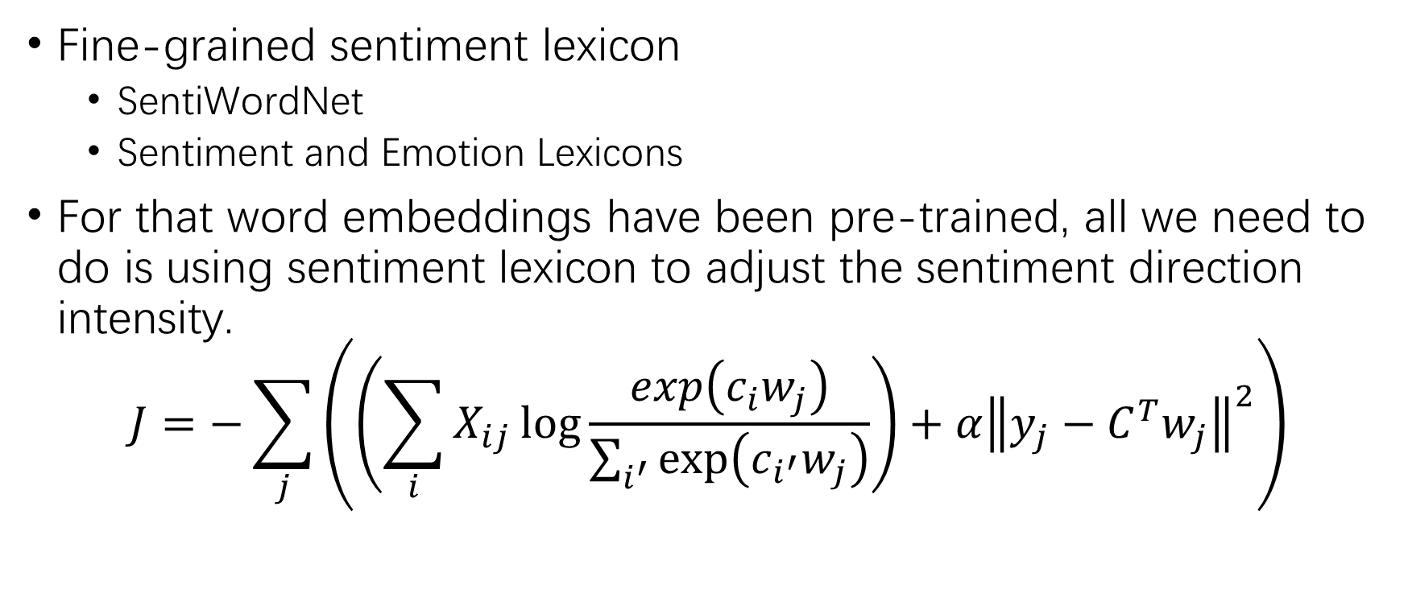
Sentiment word embeddings (my work)
Fine-grained sentiment lexicon
SentiWordNet
Sentiment and Emotion Lexicons
For that word embeddings have been pre-trained, all we need to do is using sentiment lexicon to adjust the sentiment direction intensity.
$$J=−\sum_{j}{\left(\left(\sum_{i}{X_{ij}\log{\frac{exp\left(c_{i}w_{j}\right)}{\sum_{i^{′}}{exp⁡\left(c_{i^{′}}w_{j}\right)}}}}\right)+α{\left\|y_{j}−C^{T}w_{j}\right\|}^{2}\right)}$$
Sentiment direction
Sentiment score
Pre-trained embedding

Slide 27
Sentiment word embeddings (my work)
Similarity Task
wordsim-353(pearsonr, spearmanr) (Agirre et. al, 2009)
simlex-999(pearsonr, spearmanr) (Hill et. al, 2014)
simverb-3500(pearsonr, spearmanr) (Gerz et al., 2016)
Analogy Task get a little worse, for that there are not many sentiment analogy pairs.

Slide 28
Sentiment word embeddings (my work)
 | fastText-crawl-300d-2M | refined-0.5 | refined-1 | refined-2 | refined-10 | refined-20
Top Sentiment-PCA | 0.28633193 | 0.33125759 | 0.63324688 | 0.84272089 | 9.60466751e-01 | 9.81734242e-01
wordsim-353 (329 pairs) | 0.7434 0.7890 | 0.7329 0.7780 | 0.6697 0.7219 | 0.4794 0.5959 | 0.2227 0.3243 | 0.1923 0.2853
simlex-999 | 0.5195 0.5047 | 0.5425 0.5296 | 0.5803 0.5624 | 0.5231 0.5179 | 0.3626 0.3588 | 0.3269 0.3255
simverb-3500 | 0.4454 0.4260 | 0.4718 0.4541 | 0.4874 0.4709 | 0.4114 0.4050 | 0.2737 0.2730 | 0.2457 0.2595

Slide 29
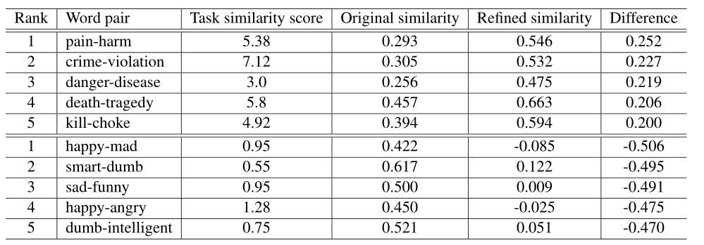
Sentiment word embeddings (my work)
simlex-999；fastText；fastText-0.5

Slide 30
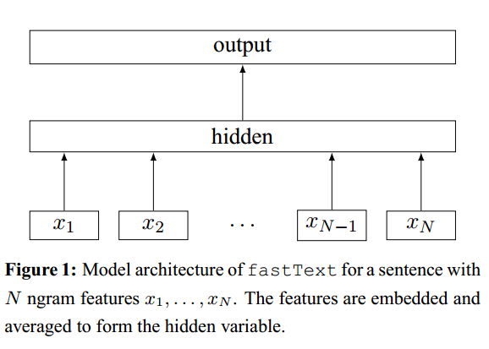
Sentiment word embeddings (my work)
What happened while training?
I take fasttext classification model(Joulin, 2016;2017) as example.

Slide 31
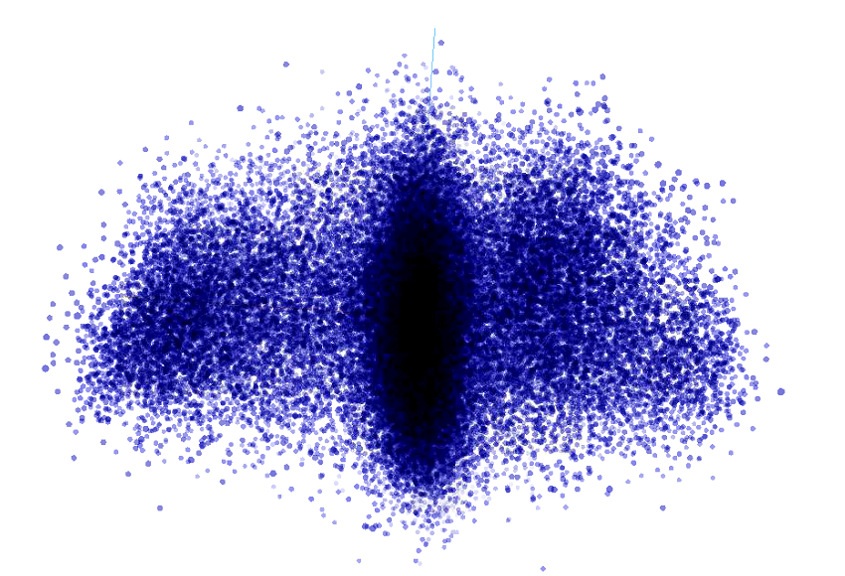
Sentiment word embeddings (my work)
bad
good
refined-2-start

Slide 32
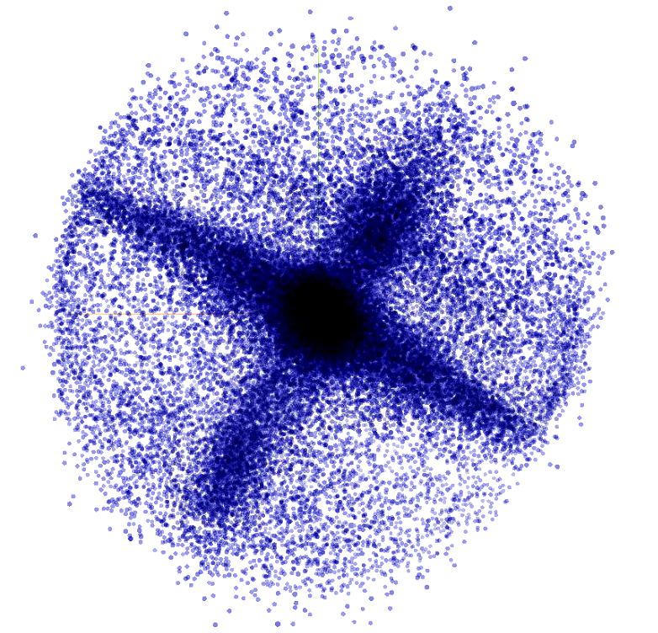
Sentiment word embeddings (my work)
bad
good
designed
generated
refined-2-epoch-1

Slide 33
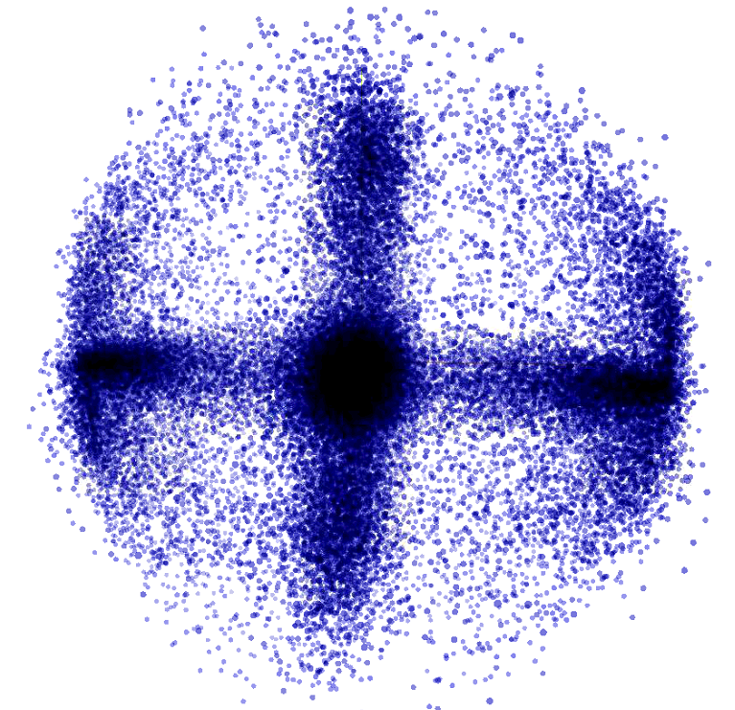
Sentiment word embeddings (my work)
good
bad
designed
generated
refined-2-epoch-3

Slide 34
Sentiment word embeddings (my work)
Unfortunately, the direction I designed didn’t work. The fasttext model generated a new direction while training.
Also, in my experiments, few pre-trained word vectors could improve models a lot, which is contradiction with routine discussed in papers. (I'm confused and need help!!!)

Slide 35
Sentiment word embeddings (my work)
Does sentiment direction of word embeddings indeed work in model?
Design several directions:
Difference of means of positive word vectors and negative word vectors
(doesn’t work)
PCA of positive word vectors and negative word vectors together
PCA of positive word vectors and negative word vectors respectively
PCA of random-picked trained word vectors
LDA of positive-negative word vectors
(doesn’t work)

Slide 36
Sentiment word embeddings (my work)
Gather the rough sentiment direction
Using distill vector on the affine subspace direction, the accuracy of model falls from 88% to 80%
Subtract sentiment direction vector from origin vector, the accuracy of model is barely over 50%
Sentiment direction works! It may be useful in compressing word embeddings.

Slide 37
Work summary
Extract sentiment direction of word embedding, which can be used to improve word vectors.
Pre-trained word embedding doesn’t help, there are still a few teething troubles to overcome.
Sentiment direction can be used in compressing word embedding.

